Slide 1
Full-Stack AI Development with Ollama
Llama, Deepseek, Mistral, Gemma and more
Vivian Aranha

Slide 2
Quick Start - Setting Up Ollama & First AI Model
Fast-track introduction to Ollama and its AI models
Install and configure Ollama, set up your development environment, and run your first AI model
Build a simple AI-powered chatbot using Llama 3 and/or Mistral
By the end of this section, you’ll be comfortable with:
Understanding Ollama and its ecosystem
Installing and setting up AI models locally
Running your first AI-powered application
Deploying a basic chatbot UI for real-time interactions

Slide 3
Full-Stack AI Development with Ollama
Llama, Deepseek, Mistral, Gemma and more
Vivian Aranha

Slide 4
Introduction to Ollama
Understanding the Foundation of AI Development
Vivian Aranha

Slide 5
What is Ollama?
Next-generation AI model deployment framework that simplifies the process of running large language models (LLMs) and AI-powered applications locally
Designed to be developer-friendly, enabling quick setup, experimentation, and production-ready deployments without extensive cloud dependencies
Key Features of Ollama:
Effortless AI Model Management
Optimized for Local & Cloud Use
Performance-Tuned Execution
Custom AI Models

Slide 6
How Does Ollama Work?
Local AI model runner, handling the execution of large language models (LLMs), computer vision, speech-to-text, and more
Here’s a simplified workflow:
Install Ollama
Download a Model
Run an AI Model
Integrate with Applications
Example: Running Your First AI Model

Slide 7
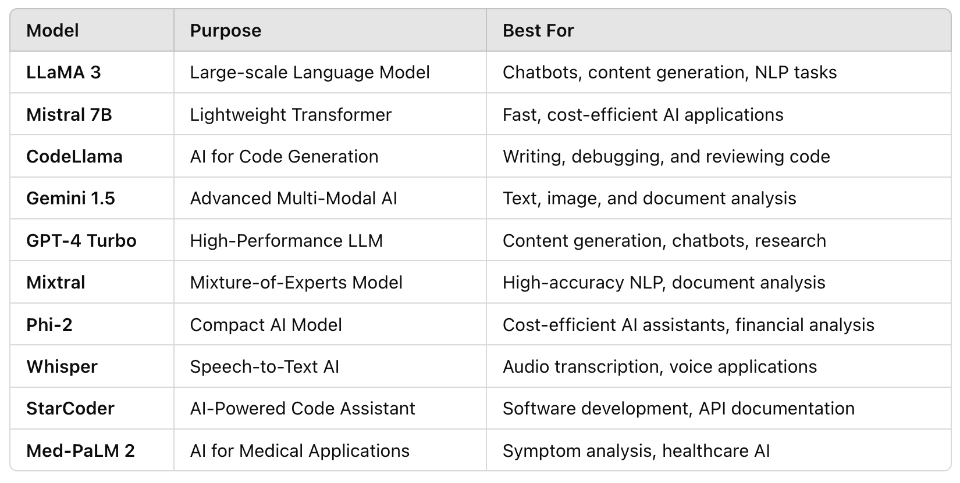
Overview of AI Models Available on Ollama
State-of-the-art AI models

Slide 8
Full-Stack AI Development with Ollama
Llama, Deepseek, Mistral, Gemma and more
Vivian Aranha

Slide 9
Installing & Setting Up Ollama
Getting Ready for AI Development
Vivian Aranha

Slide 10
Installing & Setting Up Ollama
Installing Ollama on Your Local Machine
Designed to run locally on various operating systems with minimal setup
Setting Up a Development Environment
Install Python
Set Up a Virtual Environment
Install Required Python Packages
Running Your First AI Model
Step 1: Download an AI Model
Step 2: Run a Basic AI Chat Session
Step 3: Running a Model Programmatically in Python

Slide 11
Full-Stack AI Development with Ollama
Llama, Deepseek, Mistral, Gemma and more
Vivian Aranha

Slide 12
Your First AI Project
AI Chat Assistant
Vivian Aranha

Slide 13
AI Chat Assistant
By the end of this section, you will:
Run an LLM-based chatbot using Ollama
Create a FastAPI backend to communicate with the AI model
Build a basic web UI to send messages and display responses
Step 1: Set Up the Project Structure
Step 2: Create the Backend with FastAPI
Step 3: Build the Web UI
Step 4: Run and Test Your Chatbot

Slide 14
Full-Stack AI Development with Ollama
Llama, Deepseek, Mistral, Gemma and more
Vivian Aranha

Slide 15
AI for Text Processing (NLP & LLMs)
Explore how to use large language models (LLMs) from Ollama to process, analyze, and generate text efficiently
Build practical applications using state-of-the-art NLP models like Mistral, LLaMA 3, and DeepSeek to handle tasks such as summarization, text generation, grammar correction, named entity recognition, and sentiment analysis
By the end of this section, you will:
Understand how LLMs process and generate text
Build AI-powered text tools for summarization, sentiment analysis, and more
Implement real-world NLP applications for automation and productivity

Slide 16
Full-Stack AI Development with Ollama
Llama, Deepseek, Mistral, Gemma and more
Vivian Aranha

Slide 17
AI-Powered Text Summarizer
AI for Text Processing (NLP & LLMs)
Vivian Aranha

Slide 18
AI-Powered Text Summarizer
Step 1: Project Setup
Step 2: Create the Backend with FastAPI
Step 3: Build the Web UI
Step 4: Run and Test Your AI Summarizer

Slide 19
AI-Powered Text Summarizer
Why This Project is Useful?
Saves Time
Powered by Mistral 7B
User-Friendly Interface
Expandable

Slide 20
Full-Stack AI Development with Ollama
Llama, Deepseek, Mistral, Gemma and more
Vivian Aranha

Slide 21
AI Blog & Content Writer
AI for Text Processing (NLP & LLMs)
Vivian Aranha

Slide 22
AI Blog & Content Writer
Step 1: Project Setup
Step 2: Create the Backend with FastAPI
Step 3: Build the Web UI
Step 4: Run and Test Your AI Blog Generator

Slide 23
AI Blog & Content Writer
Why This Project is Useful?
Automates Blog Writing
Uses LLaMA 3
Customizable Tone
Expandable

Slide 24
Full-Stack AI Development with Ollama
Llama, Deepseek, Mistral, Gemma and more
Vivian Aranha

Slide 25
AI Code Generator & Debugger
AI for Text Processing (NLP & LLMs)
Vivian Aranha

Slide 26
AI Code Generator & Debugger
Step 1: Project Setup
Step 2: Create the Backend with FastAPI
Step 3: Build the Web UI
Step 4: Run and Test Your AI Code Generator & Debugger

Slide 27
AI Code Generator & Debugger
Why This Project is Useful?
Speeds up coding
Debugs faster
Uses CodeLlama
Expandable

Slide 28
Full-Stack AI Development with Ollama
Llama, Deepseek, Mistral, Gemma and more
Vivian Aranha

Slide 29
AI Grammar & Spell Checker
AI for Text Processing (NLP & LLMs)
Vivian Aranha

Slide 30
AI Grammar & Spell Checker
Step 1: Project Setup
Step 2: Create the Backend with FastAPI
Step 3: Build the Web UI
Step 4: Run and Test Your AI Grammar & Spell Checker

Slide 31
AI Grammar & Spell Checker
Why This Project is Useful?
Enhances Writing Quality
Uses DeepSeek-R1
User-Friendly Interface
Expandable

Slide 32
Full-Stack AI Development with Ollama
Llama, Deepseek, Mistral, Gemma and more
Vivian Aranha

Slide 33
AI Legal Document Analyzer
AI for Text Processing (NLP & LLMs)
Vivian Aranha

Slide 34
AI Legal Document Analyzer
Step 1: Project Setup
Step 2: Create the Backend with FastAPI
Step 3: Build the Web UI
Step 4: Run and Test Your AI Legal Document Analyzer

Slide 35
AI Legal Document Analyzer
Why This Project is Useful?
Extracts Key Legal Insights
Uses Phi-2
Saves Time
Expandable

Slide 36
Full-Stack AI Development with Ollama
Llama, Deepseek, Mistral, Gemma and more
Vivian Aranha

Slide 37
Real-Time AI News Summarizer
AI for Text Processing (NLP & LLMs)
Vivian Aranha

Slide 38
Real-Time AI News Summarizer
Step 1: Project Setup
Step 2: Create the Backend with FastAPI
Step 3: Build the Web UI
Step 4: Run and Test Your AI News Summarizer

Slide 39
Real-Time AI News Summarizer
Why This Project is Useful?
Summarizes News in Seconds
Uses Qwen
User-Friendly Interface
Expandable

Slide 40
Full-Stack AI Development with Ollama
Llama, Deepseek, Mistral, Gemma and more
Vivian Aranha

Slide 41
AI for Conversational Bots & Assistants
Learn how to build intelligent AI chatbots and virtual assistants using Ollama’s powerful LLMs like QWQ, LLaMA 2, and Granite 3.2
Explore natural language understanding (NLU), multi-turn conversations, intent recognition, and AI-driven dialogue systems
Create AI-powered customer support chatbots, personal assistants, and domain-specific conversational agents, integrating them with FastAPI and web interfaces
By the end of this section
Deep understanding of AI-powered conversations
Deploy real-world chatbot applications that enhance user interactions and automate responses

Slide 42
Full-Stack AI Development with Ollama
Llama, Deepseek, Mistral, Gemma and more
Vivian Aranha

Slide 43
Customer Support Chatbot - QWQ AI Model
AI for Conversational Bots & Assistants
Vivian Aranha

Slide 44
Customer Support Chatbot using QWQ AI Model
Step 1: Project Setup
Step 2: Create the Backend with FastAPI
Step 3: Build the Web UI
Step 4: Run and Test Your AI Chatbot

Slide 45
Customer Support Chatbot using QWQ AI Model
Why This Project is Useful?
Automates Customer Support
Uses QWQ AI Model
Handles Multi-Turn Conversations
Expandable

Slide 46
Full-Stack AI Development with Ollama
Llama, Deepseek, Mistral, Gemma and more
Vivian Aranha

Slide 47
AI-Powered Virtual Assistant - LLaMA 2
AI for Conversational Bots & Assistants
Vivian Aranha

Slide 48
AI-Powered Virtual Assistant using LLaMA 2
Step 1: Project Setup
Step 2: Create the Backend with FastAPI
Step 3: Build the Web UI
Step 4: Run and Test Your AI Virtual Assistant

Slide 49
AI-Powered Virtual Assistant using LLaMA 2
Why This Project is Useful?
Automates Daily Tasks
Provides AI-Powered Assistance
Uses LLaMA 2
Expandable

Slide 50
Full-Stack AI Development with Ollama
Llama, Deepseek, Mistral, Gemma and more
Vivian Aranha

Slide 51
Medical AI Symptom Checker - MedLLaMA 2
AI for Conversational Bots & Assistants
Vivian Aranha

Slide 52
Medical AI Symptom Checker using MedLLaMA 2
Step 1: Project Setup
Step 2: Create the Backend with FastAPI
Step 3: Build the Web UI
Step 4: Run and Test Your AI Medical Assistant

Slide 53
Medical AI Symptom Checker using MedLLaMA 2
Why This Project is Useful?
Provides Quick Health Insights
Uses MedLLaMA 2
Automates Symptom Analysis
Expandable

Slide 54
Full-Stack AI Development with Ollama
Llama, Deepseek, Mistral, Gemma and more
Vivian Aranha

Slide 55
E-Commerce AI Product Recommender - Granite 3.2
AI for Conversational Bots & Assistants
Vivian Aranha

Slide 56
E-Commerce AI Product Recommender using Granite 3.2
Step 1: Project Setup
Step 2: Create the Backend with FastAPI
Step 3: Build the Web UI
Step 4: Run and Test Your AI Product Recommender

Slide 57
E-Commerce AI Product Recommender using Granite 3.2
Why This Project is Useful?
Enhances Customer Shopping Experience
Uses Granite 3.2
Automates Product Discovery
Expandable

Slide 58
Full-Stack AI Development with Ollama
Llama, Deepseek, Mistral, Gemma and more
Vivian Aranha

